Slide 1
Software Engineering and Architecture
Writing Clean Code

Slide 2
Motivation
Code is written to
Be compiled, deployed, and executed by users in order to serve their need
So we make money, get salaries and can buy presents for our spouses (or children, or cats, or whatever…)
Be maintained – that is - read and understood by humans so it can easily and correctly modified

Slide 3
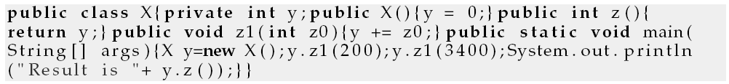
Motivation
Functionally correct code can be next to impossible to maintain…
The code below correctly reflect a well known text book example. Which?
Morale: Write Clean Code

Slide 4
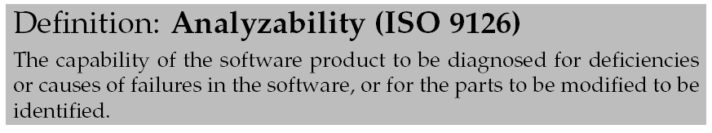
Analyzability
Basically:
can I understand the code fast?
Is my understanding correct?

Slide 5
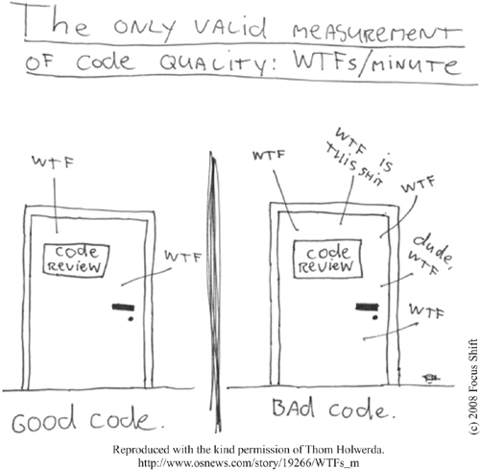
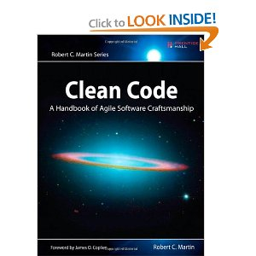
How to ?
Clean Code?
Not an exact science !!!
Kent Beck: ”Code smell”
WTF measure
Certainly partly matter of taste!
Not invented here syndrome…
Our Take at it
Uncle Bob ”Clean Code”
On Functions and Comments
Uncle Henrik
My own prejudices and tastes ☺

Slide 6
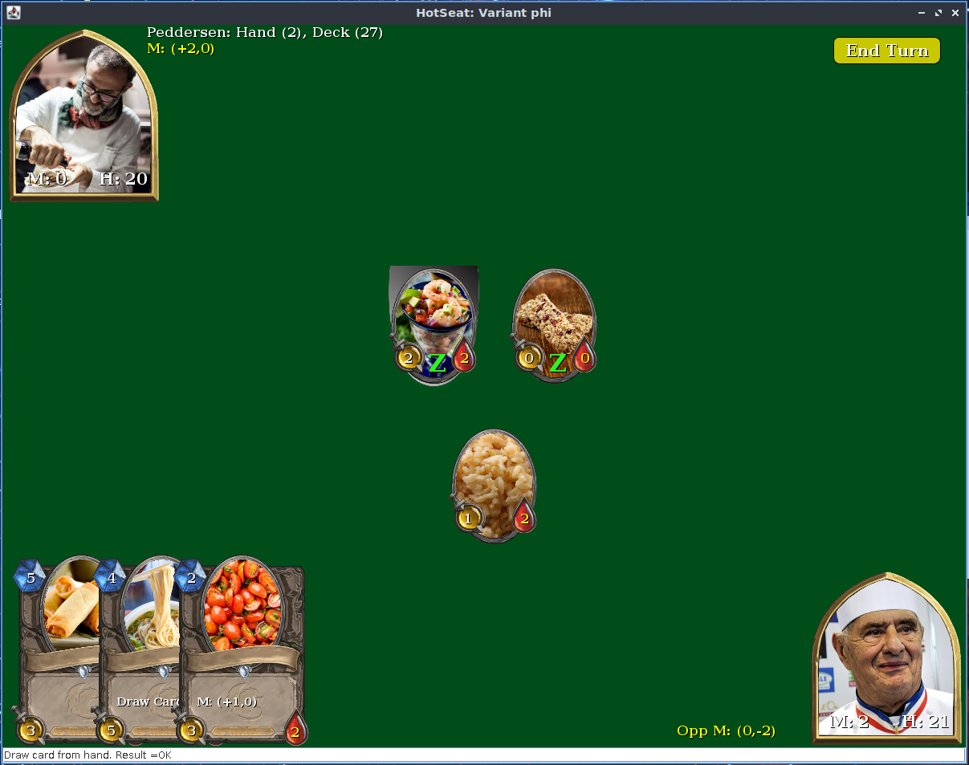
Exercise
We will be looking at game.attackCard(p, aC, dC)
For AlphaStone
My unclean impl:
Used own test cases
Developed attackCard (and other) methods from scratch
With inspiration from student’s code ☺

Slide 7
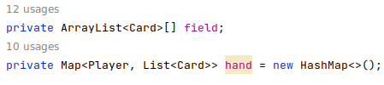
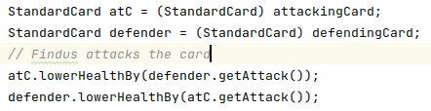
Context
attackCard(Player attPlayer, Card attCard, Card defCard)
(Weird) Choice of data structures in StandardGame
Battlefield is ARRAY with index 0 = findus and 1 = peddersen
Hand is Map with key = player and value = List<Card>
The implementation ensures all Cards are instances of StandardCard, so casts are valid, to access mutators on cards ala
Notes:
[Meta: Git rep ‘frsproject’, sub project ‘clean-code-lecture’ on master branch]

Slide 8
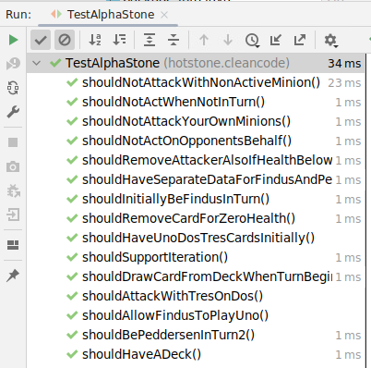
TDD TestList => Test Cases
My own test suite of AlphaStone, however, removed all ‘non attack card’ related stuff…
Etc…
Notes:
I created a set of test cases for testing the group’s codebase. Generally, their code was functionally correct.

Slide 9
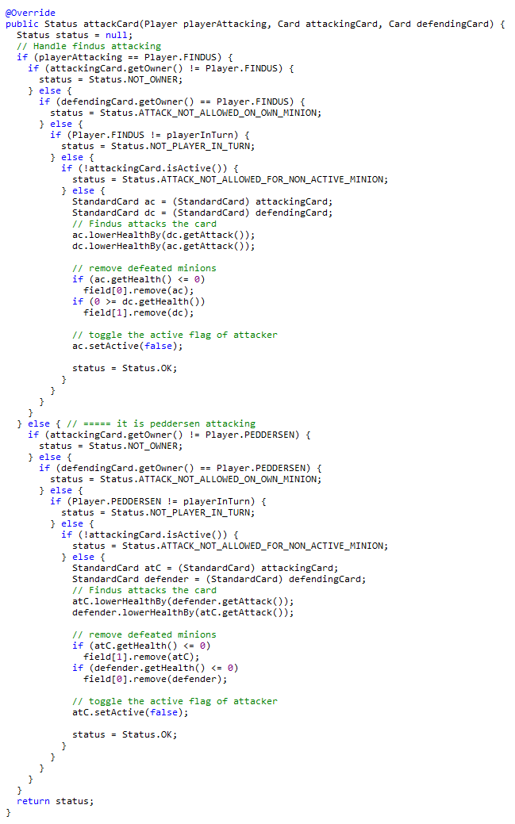
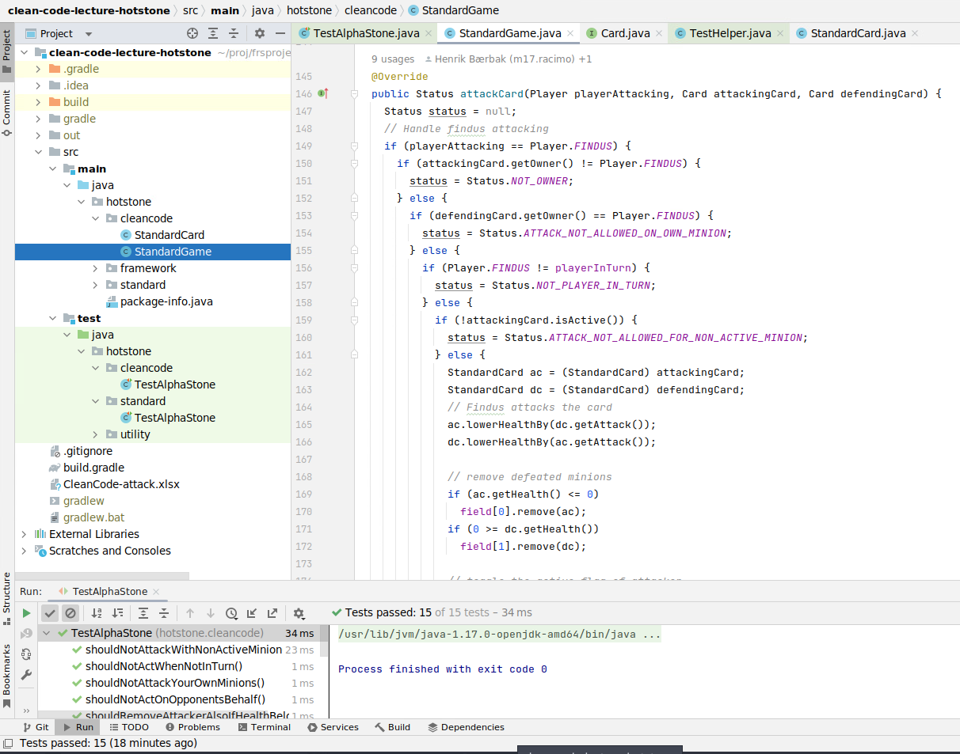
The Method
About “3 screens” of code
Functionally correct AlphaStone attack!
(Also on BS.)
Notes:
[Meta: Version 4527 of code base / my-solutions/dsoftark/tdd-own-solution]

Slide 10
Clean Code Properties
A Classification Template

Slide 11
Classification Scheme
An attempt at systematics…
Method Name:
Wanted property | is OK | Example/argument
Small
Do One Thing
One Level of Abstraction
Use Descriptive Names
Keep Number of Arguments Low
Avoid Flag Arguments
Have No Side Effects
Command Query Separation
Prefer Exceptions to Error Codes
Don't Repeat Yourself
Do the Same Thing, the Same Way
Name Boolean Expressions
Bail out Fast
Arguments in Argument Lists

Slide 12
Bob’s Properties
Small
Make it do 1-5 logical steps / ‘functional nuggets’
Do One Thing
Do one thing, do it well, do it only! Keep focus!
One Level of Abstraction
The dean does not edit spelling errors in my slides!
Use Descriptive Names
Tell the one thing it does! Do not tell anything else
Keep Number of Arguments low
0-1-2 maybe three arguments. No more. If more, your method does more than one thing!

Slide 13
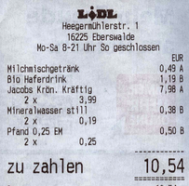
DOT + OLoA
Think code as a military hierarchy
General: overall movement of armies
Major: executive of battalions
Private: wading through mud
Example: A Point-of-Sales system / ”Føtex kasse”
Goal:
Scan purchased items
Produce till receipt
Update warehouse inventory
Notes:
Batalion = 800-1200 mand

Slide 14
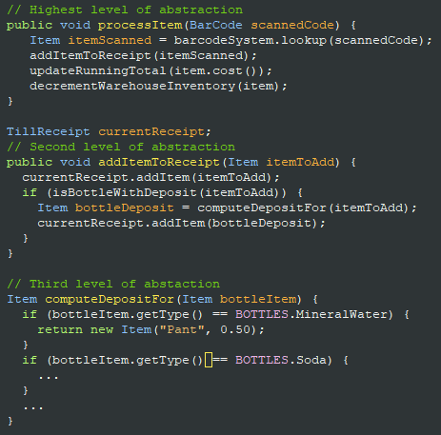
A Properly Leveled Implementation
Overall Algorithm level ‘General’
TillReceipt handling level ‘Major’
Low level computation level ‘Private’

Slide 15
Bob’s Properties
Avoid Flag Arguments
produceWebPage(true, true, false); Huh???
Boolean arguments says ”do more than one thing!” Right?
Have No Side Effects
Do not do hidden things / hidden state changes
It will fool the client; and will hide weird bugs
Ex: init a session; modify the object passed as argument
If it does, the descriptive name, should reflect it!

Slide 16
Bob’s Properties
Command Query Separation
Setters and Getters Accessors and Mutators
Query: no state change!!! Return a value.
Command: no return value(hm) Change the state
Prefer Exceptions to Error Codes
Not ‘int addPayment(int amount)’ that returns error code 17 in case it is an illegal coin
Networking is an exception – it cannot propagate exceptions
Don’t Repeat Yourself
Avoid Duplicated Code
To avoid multiple maintenance problem

Slide 17
Don’t Repeat Yourself
That is
Why?
Multiple maintenance problem !!!
Root of (almost) all Evil
Avoid Duplication

Slide 18
In Detail

Slide 19
Clean Code
Additions by Uncle Henrik

Slide 20
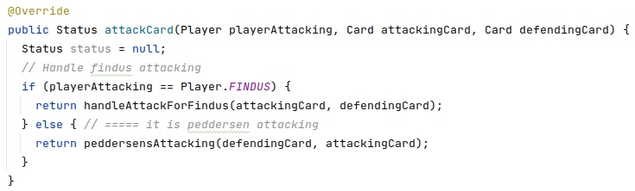
Arguments in Argument Lists
One symptom on duplicated code is the use of ‘arguments’ in the method/class names
addOneToX(int x); addTwoToX(int x); addThreeToX(int x); ???
Important exception!
Test case methods often hardcode values and parameters in the method names
An argument appears as part of the method name
Notes:
META: Branch ‘cleancode-args-in-arg-list’

Slide 21
Do the Same Thing, the Same Way
Akin to Uncle Bob’s Do One Thing but not quite…
Why?
Analyzability
WarStory
DSE ‘string copy’
Changed the ordering of arguments compared to standard !?!?!
Do the same thing, the same way
Notes:
In the C library all functions that operate on a strings (copy, compare, …) have parameters (destination, source) in that order. My collegue had reversed it in his special copy function.

Slide 22
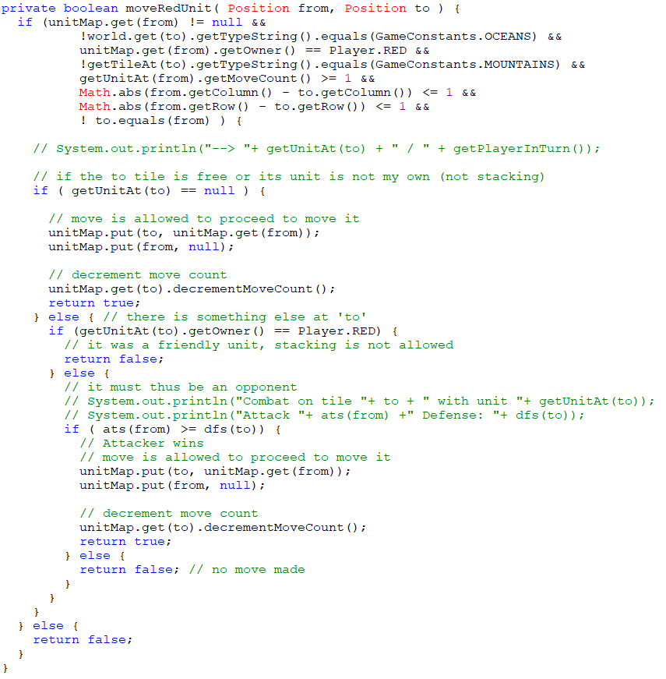
Do the Same Thing, the Same Way
Within classes you have the option to either
Use accessor method
Or direct data structure access
Do same thing same way…
Use the access method
Allows changing datastructure!
Do the same thing, the same way
Notes:
In the C library all functions that operate on a strings (copy, compare, …) have parameters (destination, source) in that order. My collegue had reversed it in his special copy function.

Slide 23

Curiosum
Do the same thing the same way…
Global consistency in all respects is difficult ☺
Do statements end in a dot or not?
Is ‘up-to-date’ with or without dashes..

Slide 24
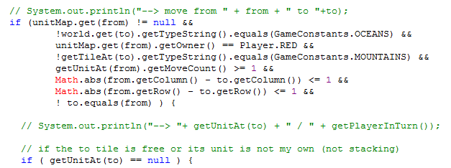
Name Boolean Expressions
Boolean expressions are difficult to read!
One big ball of mud of && between boolean computations ☹

Slide 25
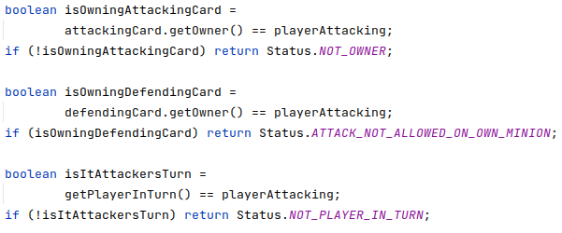
Name Boolean Expressions
Name each subexpression so we can read what it is!
Give each boolean expression a name.
Make name positive!
Do not put ‘not’ into the Boolean name:
isNotMyCard
then what is
if (! isNotMyCard) … ???

Slide 26
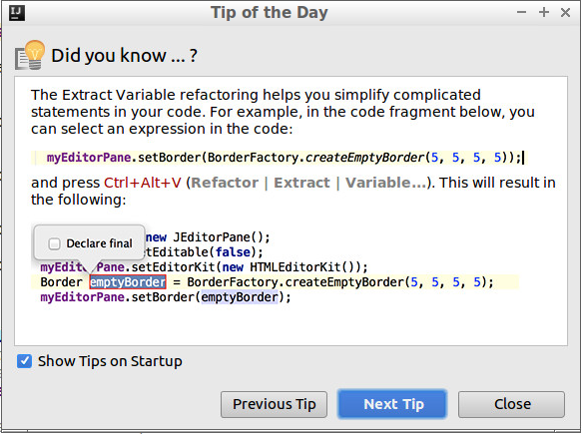
And Help from My Friends

Slide 27
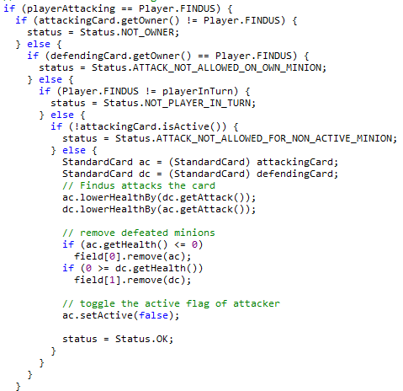
Bail out fast
When lots of conditions must be checked, I often see deep nesting of if
Empirical studies show that humans cannot cope well with nesting levels deeper than 1-2 !
You can write it, but cannot maintain it

Slide 28
Bail out fast
Flatten it, by bailing out as soon as an answer can be computed
Bail out fast

Slide 29
Agile Method Development
Like any other creative process, you do not do it in one brilliant step!
Kent Beck:
Clean code that works but not in that order
Make it work, then make it clean
Commit horrible sins, and then clean up the mess

Slide 30
Analysis

Slide 31
Five minutes: Spot properties

Slide 32
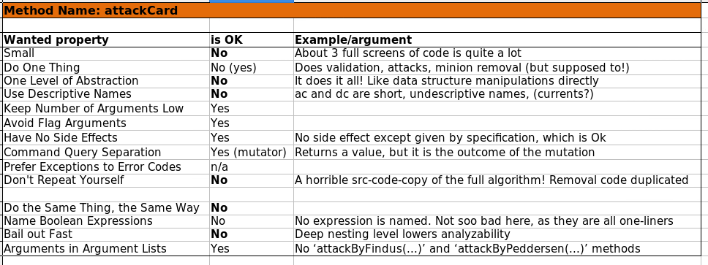
My Analysis

Slide 33
Refactoring Session
Screencasted Coding Session

Slide 34
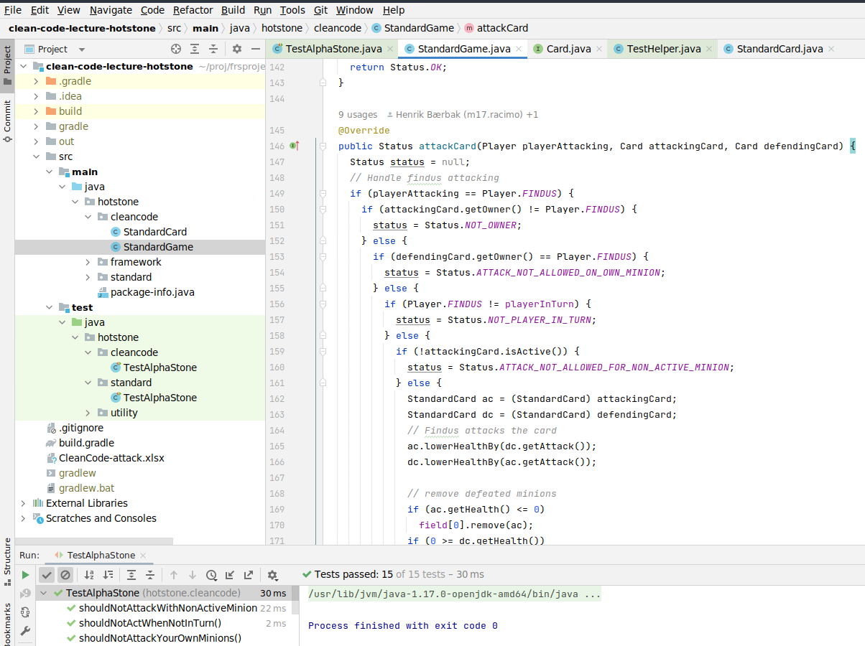
Let us clean up…
Find screencasts on the week schedule!

Slide 35
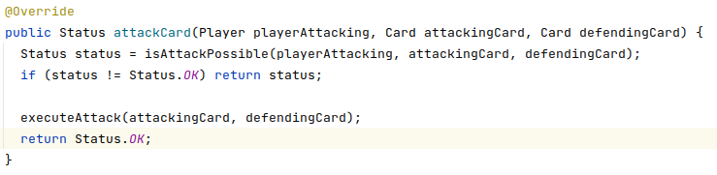
45-60 Minutes Later
Notes:
Code is from Screencast session 2020.

Slide 36
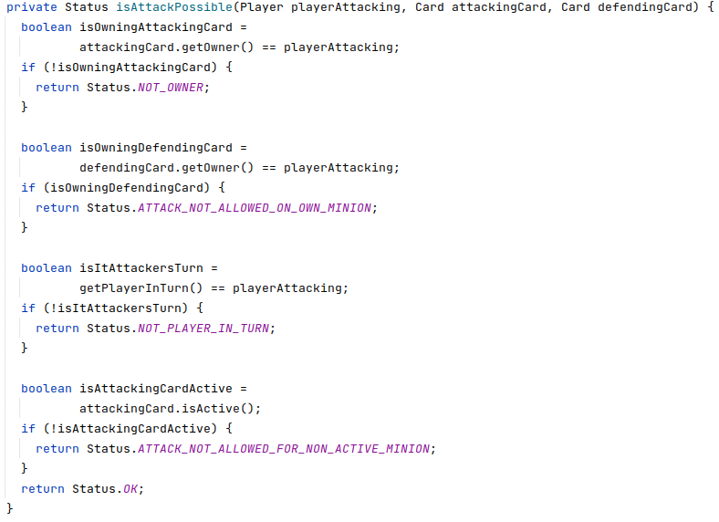
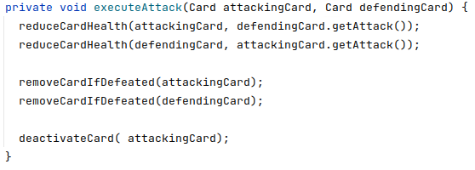


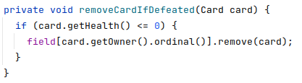
Next level methods

Slide 37
Afterthoughts

Slide 38
The Two Codebases
TDD produce two large codebases
The production code
The test code
The properties of clean code apply to both
You want to be able to read test code also! (Analyzability)
Except one property: Arguments in Argument Lists
In test code, you often ‘hardwire parameters’ / no abstraction
Example: ”private void moveRedArcherToPosition45()”
Encapsulates the moves of particular unit to particular position in order to do testing!

